Slide 1
Wine Quality Prediction
BY:
17BCP010 – Twinkle Bhimani
17BCP012 _ Yash Bokil
17BCP013 _ tanmeet Butani

Slide 2
PROBLEM STATEMENT
Using linear regression algorithms for predicting discrete(but integral) values of wine quality dataset, and predicting the same values using their classification algorithms and finding the difference between both by evaluating using appropriate evaluation methods for both.

Slide 3
Methodology
Using Scikit Learn python library to train a linear regression model and support vector machine model(also KNN) for wine quality dataset and comparing the differences by plotting difference between actual and predicted methods on graph using matplotlib, also comparing precision,recall,f1-score and support score using classification report in scikit learn.

Slide 4
Instructions
Open the test.ipynb file in VSCode or Google Colab
for VSCode.
Run the file, making sure the winequality.csv file is in the wine folder in the root folder."./wine/winequality.csv“ for Google Colab.
Upload the notebook test.ipynb to Google Colab. Now add the winequality.csv in the runtime file explorer of Colab. Change the address of the file in the test.ipynb which you just uploaded to Colab to "winequality.csv" from "./wine/winequality.csv"

Slide 5
Outcome
Linear regression is able to predict discrete values given that the values are integral, as seen in the winequality dataset. Also, scoring the Linear Regression model based to root mean squared error and comparing the score against SVM(also KNN) model ofd classification realm scored using accuracy.

Slide 6
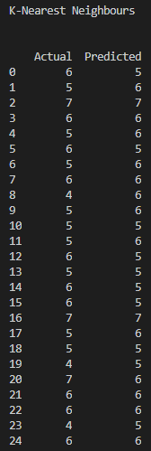
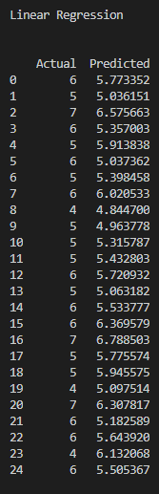
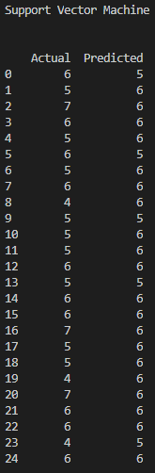
SCREENSHOTS OF OUTPUT PREDICTION TABLE
KNN prediction Table
Linear Regression table
SVM prediction table

Slide 7
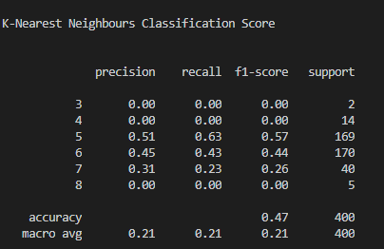
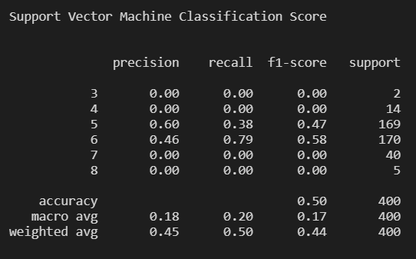

SCREENSHOTS OF OUTPUTS ACCURACY SCORE AND ERROR
KNN ACCURACY SCORE
SVM ACCURACY SCORE
LINEAR REGRESSION ERROR

Slide 8
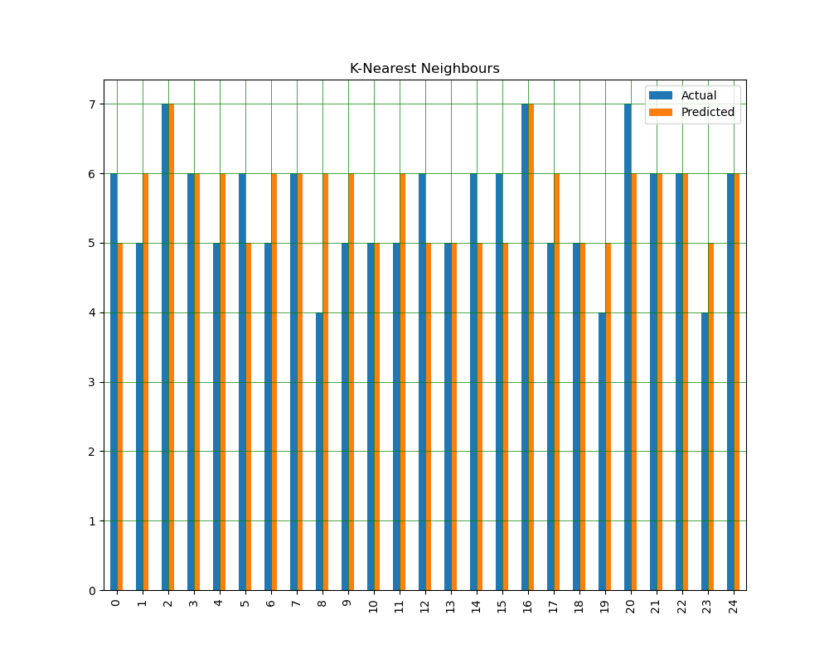
K-NEAREST NEIGHBOUR GRAPHS
K-NEAREST NEIGHBOUR GRAPH

Slide 9
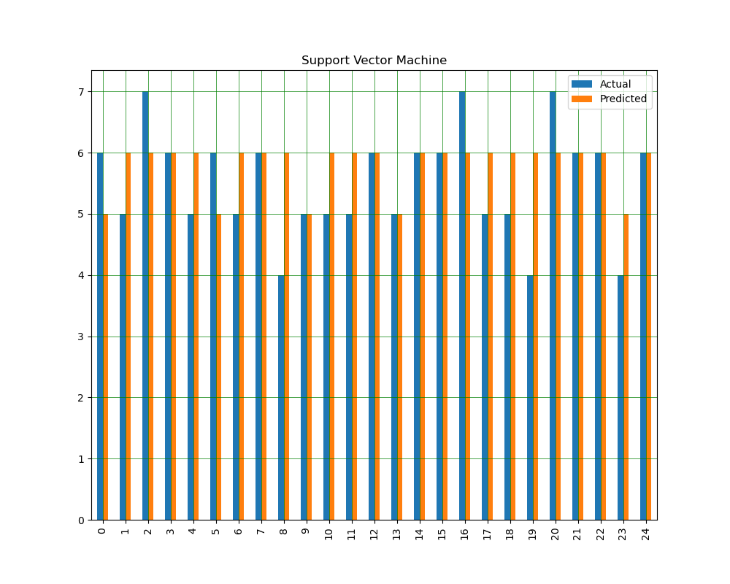
SUPPORT VECTOR MACHINE GRAPHS
SUPPORT VECTOR MACHINE

Slide 10
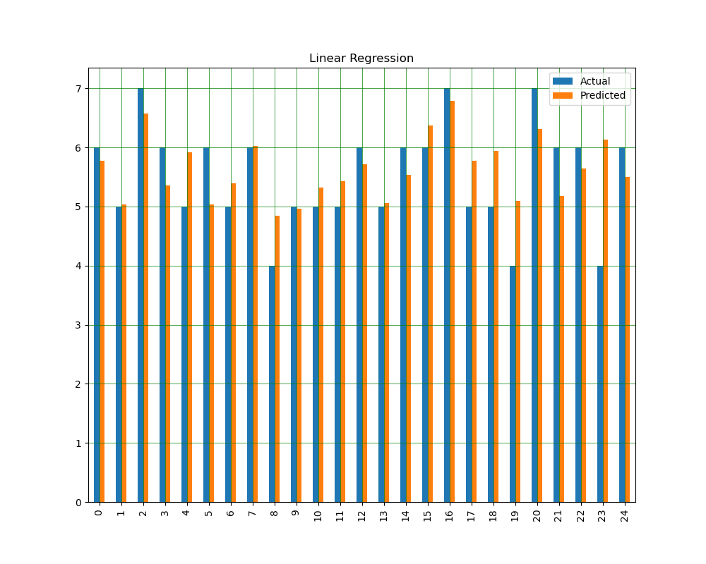
LINEAR REGRESSION GRAPH
LINEAR REGRESSION

Slide 11
Conclusion
A regression algorithm may predict a discrete value, but the discrete value in the form of an integer quantity." Quoted from Machine Learning Mastery.

Slide 12
References
References -
https://towardsdatascience.com/a-beginners-guide-to-linear-regression-in-python-with-scikit-learn-83a8f7ae2b4f
https://www.kaggle.com/muammerhuseyinoglu/prediction-of-wine-quality
https://machinelearningmastery.com/classification-versus-regression-in-machine-learning/

